Slide 1

Automating Business Processes Using SharePoint Designer
Tesfaye Gari
Sr. SharePoint Architect MTM Consulting Group www.mtmconsultinggroup.com
tgari@mtmconsultinggroup.com

Slide 2
Contents
► What is a workflow?
► Types of SharePoint Workflows & component
► Workflow Demo
► Workflow Best Practices & Common Issues
► Changes in SharePoint 2013
2

Slide 3
What is a Workflow?

Slide 4
What is a Workflow
► “The steps required to complete a process”
► A workflow can have the following attributes.
May include Steps that must be completed by multiple people in an organization or even outside an organization
Interaction with multiple systems and applications (integration)
Notification or alerts to let people know when they need to perform a task related to a workflow (email, SMS)
Branching logic that chooses the next step based on the result of the current task
Can be long running (hours or even days)
May need to request data from users

Slide 5
Examples
► Internal
HR - Vacation Request, New Hire, performance reviews
IT – help desk, equipment procurement
► Internal & External
Loan Application
College application
Job Application

Slide 6
Evolution of workflows
► Manual
Process
Paper forms, folders, mail, fax
Issues
Slow, no visibility, error-prone
► Email
Process
PDF/Word forms, shared folders, email
Issues
Better – but still no visibility into status
No central location to see status and results
Relies on user to follow rules
Which is the correct/latest form?
► SharePoint
Process
Lists/InfoPath forms, SPD workflow, email for notification
Issues
Provides central location to view status and results
Provides personalized work queue for users
Rules documented and enforced
Email only used for notification

Slide 7
Types of SharePoint Workflows

Slide 8
Type of SharePoint Workflows
► SharePoint Designer
Supports only sequential workflows (more powerful in 2013 with loop and transition to stage “goto”)
Types
List Workflow
Reusable Workflow
Site Workflow
► Visual Studio
Custom code-based workflows (only SP 2010)
Deploy as a WSP file to a farm
Supports sequential and state machine workflows ( SP 2010)

Slide 9
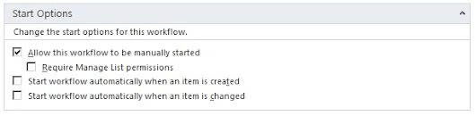
Designer – List workflow
► Simplest workflow to create
► Workflow is tied directly to a list or document library
► Cannot be re-used for other lists
► Cannot be published globally.
► Cannot be saved as a template (WSP).
► Cannot be associated with a content type.
► Cannot be exported easily

Slide 10
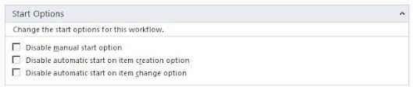
Designer - Reusable workflow
► Not required to be linked to a specific list or content type – Similar to built in workflows
► Can be published Globally which allows the workflow to be used in all sub-sites in site collection
– Must be created at top level site and user must be an site admin at top level
► Can be saved as a Template which will create a WSP file in the SiteAssets library
► WSP File Can be imported into Visual Studio - for more advanced options - one-way trip – cannot go back to designer
► Can be associated with a Content type (2010 only) or a list
10

Slide 11
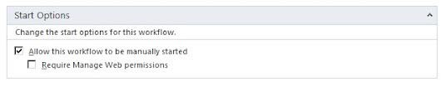
Designer – Site workflow
► A workflow that runs at the site level – not linked to a list or content type
► Does not have a current item
► Execute from “All Site Content” page on the site

Slide 12
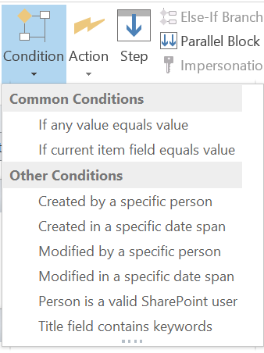
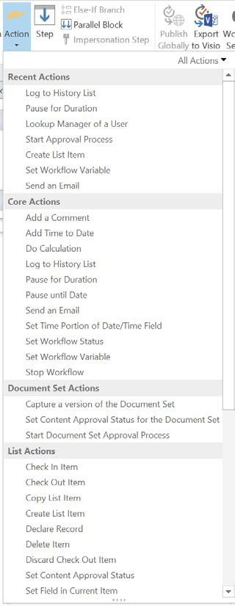
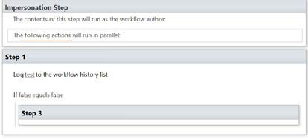
SharePoint Workflow Components (2010 & 2013)
► Steps – group actions logically
► Condition – if then statements
► Actions – do things
► Impersonation Step (2010) – run step as user that created the workflow
► Parallel Block - Execute actions at the same time
► Local variables – hold data that is global to the workflow

Slide 13
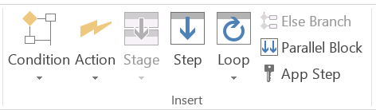
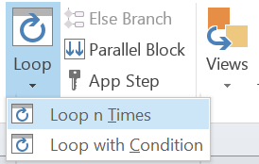
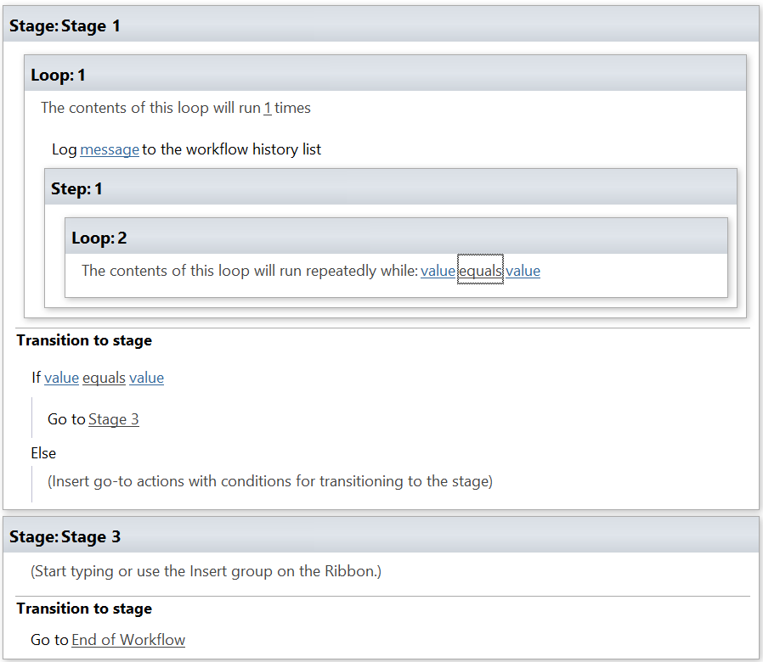
SharePoint Workflow Components (2013)
► Stage – group steps and actions. Support transition to stage (goto)
► Loop – Execute step multiple times in a stage
► App Steps – run step as super user (like impersonation steps in 2010)

Slide 14
Demo – Vacation Request

Slide 15
Business Issue
► Employee’s manager must approve vacation requests from employees and HR should be notified when a vacation request is approved
► Flow
Employee enters request
Approval task assigned to manager (can use AD manager lookup)
If manager approves
Notification sent to HR
Notification sent to Employee
Vacation added to department calendar
If rejected
Notification sent to Employee who can update and re-submit
16
11/4/2015

Slide 16
Show Demo
► Show Demo

Slide 17
Highlights
► Create custom URL to “new vacation request” which includes
return URL (https://nrecacoop.sharepoint.com/sites/mtm/vacation/Lists/VactionReque st/NewForm.aspx?Source=https%3A%2F%2Fnrecacoop.sharepoint.com%2Fsites%2Fmtm)
► “Task Process” action handles approval process with tasks, emails, and reminders
► Functionality broken into separate steps to improve maintainability and readability of workflow
► SharePoint 2013 on Office 365

Slide 18
Workflow Best Practices & Common Issues

Slide 19
Software Development Lifecycle
► Build a workflow is essentially the same as writing code in a controlled environment
► Development Lifecycle
Gather requirements
High level business requirements – the business issues you are trying to address
Low level – functions required
Architecture & Design
Architecture - how the solution will be constructed at a high level
Design - low level description of how components will be built
Prototype
If requirements are fuzzy a prototype can help to iterate on a solution
Develop
Build the solution and unit test to ensure the component works in the development environment
QA Testing –
A QA or business analysts tests solution fully. Make sure to try all use cases and exercise all workflow paths to ensure workflow functions correctly.
Deploy to production
User acceptance testing – have business users test solution and validate functionality
Go Live – put into daily use
Maintenance Mode – perform entire lifecycle again for enhancements and bug fixes
20

Slide 20
Requirements and Design tips
► Start out simple – scope creep can derail the process
► Automate as much of the process as possible with an understanding that there may be manual steps which are replaced over time
► For example
Problem
The business requirements identity the need to access an HR system to lookup the manager of a user.
This requires a large design and development effort to integrate with the HR system
Solution
Ask the user to enter their manager as part of the process
Use a lookup list with user to manager mapping
Expand the solution later to include HR system integration

Slide 21
Testing
► Testing workflows is difficult
Multiple users involved at different levels of the business
Difficulty moving from test environment to production
Reliant on external global data such as AD settings
► Tips
Configure test users – make sure to assign an email address
Ensure you test all workflow paths
Use “log to history” action to track flow and allow debugging in a production environment
Use workflow variables to hold user names when possible to allow quickly changing from test users to real users
Use workflow variables to share email “snippets” across emails to ease maintenance of workflow

Slide 22
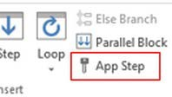


Security
► What user does my workflow run as?
Regular steps – runs as user who initiated the workflow
Impersonation step (SP 2010 only) – runs as user who published the workflow
App Step (2013) – has read/write access to all lists in site (Site Feature-> Enable Workflow Task Content Type)
► Issues
Workflow can break if impersonation steps are used and account that published the workflow is deactivated (2010)– use a system account to prevent this
Very carefully plan for permissions in your workflow. Make sure you know where exactly you are getting data from and what data you are going to modify and ensure that every potential workflow user has permissions to all these objects.

Slide 23
Synchronous or Asynchronous (2010)?
► When a workflow starts – automatically or through a manual execution it runs synchronously up to the point where there is a delay - at that point it is suspended
► A suspended workflow is executed in the timer process on a schedule (default is every 5 minutes)
► Issues
To reduce the impact on the user of starting a workflow a delay action can be added early in the process to move the workflow to the timer process
A delay in the timer process can not be below the timer process scheduled delay ( default is 5 minutes) – so a delay of 1 minute can take >=5 minutes
► 2013 workflows run in workflow manager and are always asynchronous and can have delays with 1 minute resolution

Slide 24
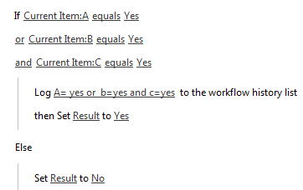
Logic Issues
► When mixing “AND” and “OR” logic in a workflow the outcome may not be what is expected
► Designer workflow do not have parenthesis
a or b and c
► By default the statement a or b and c is evaluated as (a or b) and c
► If you want a or (b and c)
Rewrite as B and c or a
Or calculate b and c put into variable x
Then use a or x
► “Read” left to right or top to bottom in designer

Slide 25
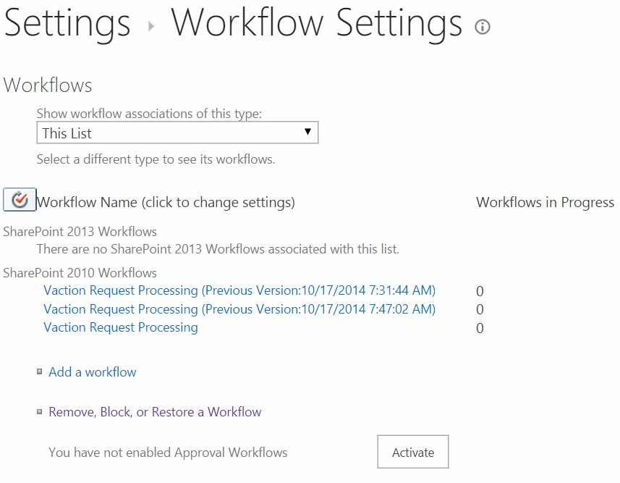
Versioning (2010)
► Each time a workflow is published a new version is created
► Old versions are renamed with date
► Old versions can be deleted
► 2013 does not create (visible) version workflows but does handle versioning

Slide 26
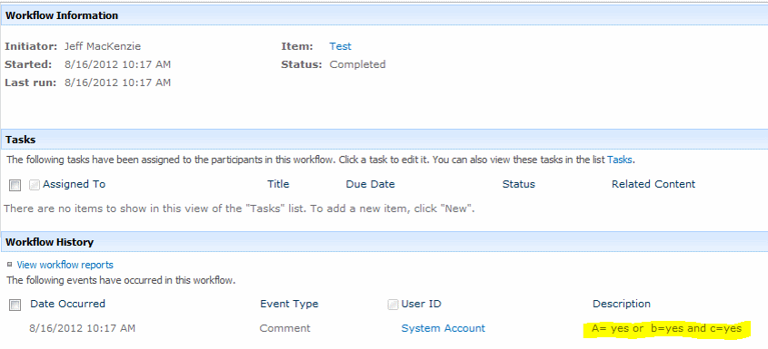
Debugging
► To allow debugging a workflow in production the “Log to history list” action should be used at key places in the workflow.
► Messages passed to this action will be visible in the workflow details screen.

Slide 27
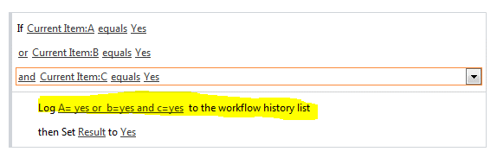

Debugging (Log Example)

Slide 28
Workflow History
► Workflow history is a “hidden” list that is created on the sites that have workflow
► The list holds the workflow history and is used to populate the “workflow information” screen
► To access the list add “Lists/Workflow%20History/AllItems.aspx” to the site URL.
– For example, if the site is http://test.dev.mtm.com/test then the history URL is http://test.dev.mtm.com/test/Lists/Workflow%20History/AllItems.aspx
► By default, a timer job removes data from this list after 60 days.
► If you want to keep the History List for an extended time, you can update the settings in Central Administration>Operations>Global Configuration>Timer Job Definitions.( http://technet.microsoft.com/en- us/library/ee662522(v=office.14).aspx)
► Not intended to be used as permanent audit log

Slide 29
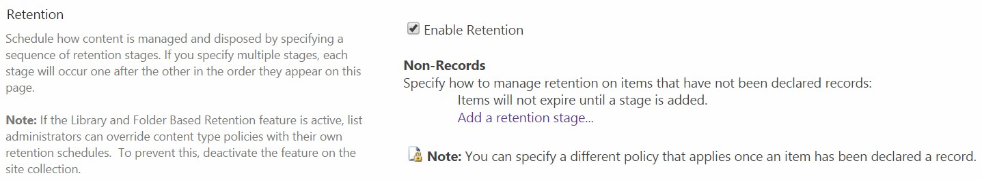
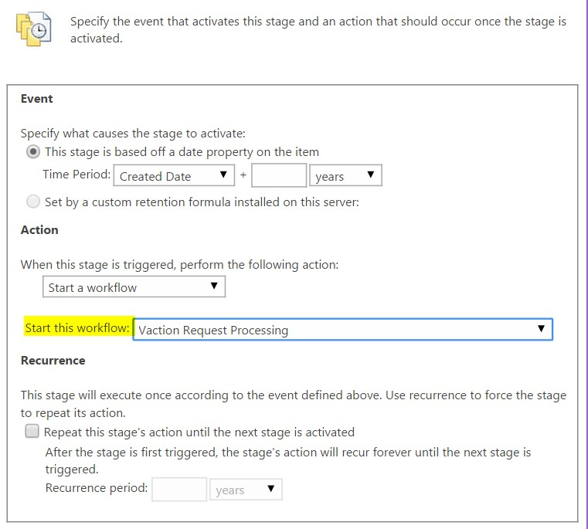
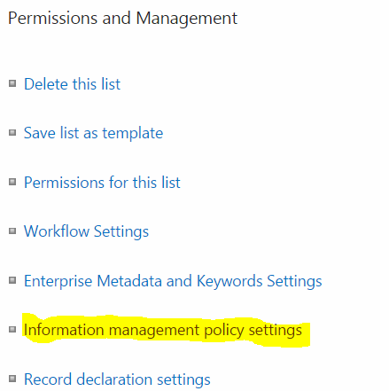
Trigger Workflows Based on a Date
► Use Information retention policy to triggers a time-based workflow using a item Date property (2010 Workflows only)
► Note: Expiration Policy Timer Job Runs weekly in SharePoint online (O365)
30

Slide 30
What’s new in SharePoint 2013

Slide 31
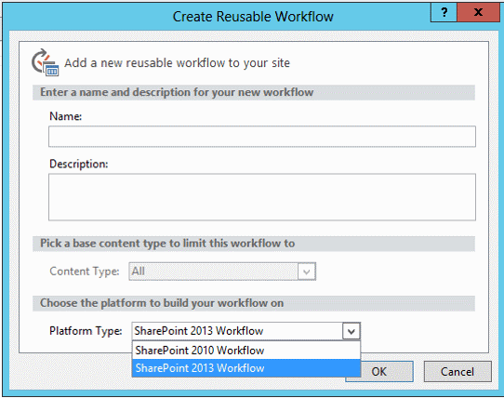
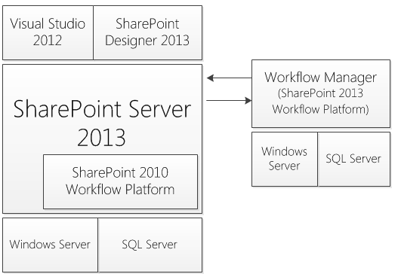
New Features
► Adds a new workflow engine (based on Workflow Manager)
2010 engine is still available
Requires additional setup steps to install
Must choose version when creating a new workflow

Slide 32
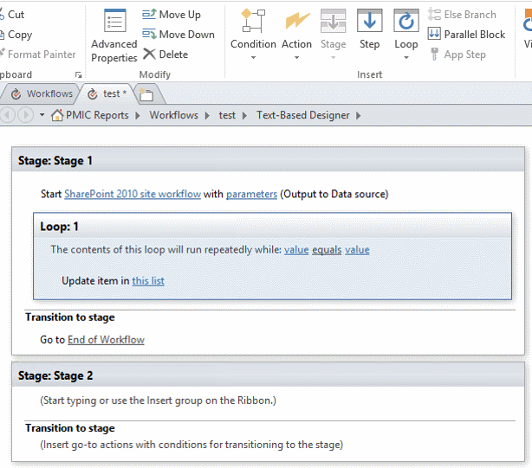
New Features
► 2013 Workflow Features
More powerful workflow constructs including
Looping
“Goto” a stage
Start a workflow – including 2010 workflows
Call web service
Dictionary type to hold collection of name/value pairs

Slide 33
Limitations
► No more Visual Studio Workflows with code – only declarative
– Call web services for custom code/integration
► No more InfoPath forms – just Asp.Net forms
► Reusable workflow cannot be tied to a Content Type
► Relies more on calling SharePoint REST API to integrate with SharePoint
► Discontinued features (highlighted)
Add List Item
Inherit List Item Parent Permissions
Remove List Item Permissions
Replace List Item Permissions
Collect Data from a User
Start Approval Process (start a task process)
Start Custom Task Process
Start Feedback Process
Conditions:
If current item field equals value
Check list item permission levels
Check list item permissions
Impersonation Step
Data sources:
User Profile lookup
Other features:
Visio integration
Association Column
'Require Manage List/Web Permission' feature for list/site workflow
– Actions:
– Steps:

Slide 34
Discontinued Features – full list
► Discontinued Features
Actions:
Stop Workflow
Capture a Version of the Document Set
Send Document Set to Repository
Set Content Approval Status for the Document Set
Start Document Set Approval Process
Declare Record
Set Content Approval Status
Undeclare Record
Add List Item
Inherit List Item Parent Permissions
Remove List Item Permissions
Replace List Item Permissions
Lookup Manager of a User
Assign a Form to a Group
Assign a To-Do Item
Collect Data from a User
Start Approval Process
Start Custom Task Process
Start Feedback Process
Copy List Item (SharePoint Designer 2013 supports only the document-copying action.)
Conditions:
If current item field equals value
Check list item permission levels
Check list item permissions
Impersonation Step
Data sources:
User Profile lookup
Other features:
Visio integration
Association Column
Content Type Association for reusable workflow
'Require Manage List/Web Permission' feature for list/site workflow
Globally reusable workflow type
Workflow visualization option
– Steps:

Slide 35
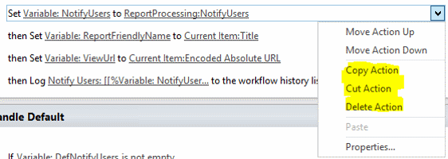
New Features of SharePoint Designer 2013
► Copy and Past support for actions and steps for both 2010 and 2013 workflows
– Both within a workflow and between workflows, and across sites
► Support for new 2013 workflows

Slide 36
Questions

